Slide 1
The Island of Love…
OBLU-lobigili.COM

Slide 2
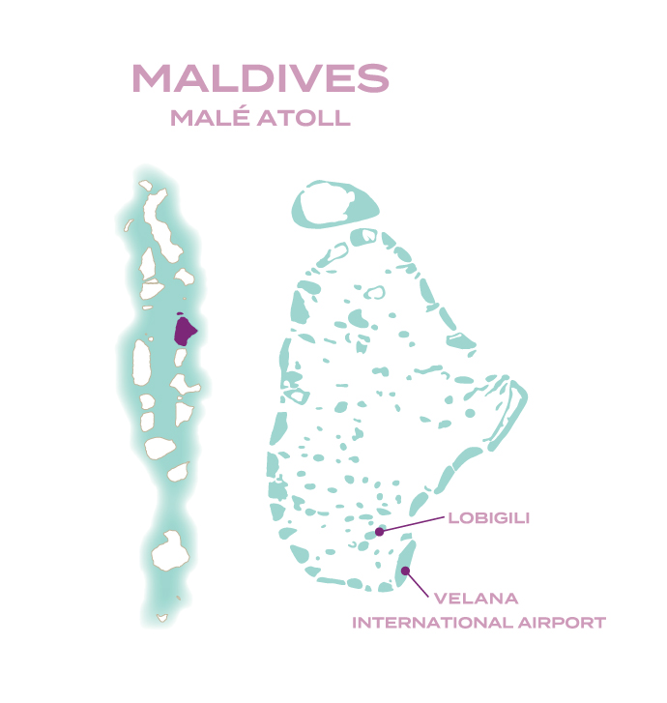
Resort Features
Key USPs
All adult private resort
68 VILLAS IN 3 categories
Creative a la carte dining with live cooking stations and theme nights at Ylang-Ylang restaurant
Just 15-Minutes from Airport
Unique food truck dining experience at Gaadiya 17
Sunset bar – SWING overlooking the turquoise lagoon
Largest Under Ocean Restaurant Only BLU
Access to neighboring resort OBLU XPERIENCE Ailafushi with all – day dining restaurant, vibrant X360 bar with additional recreational facilities, live entertainment during the evening and retail cafe zone with wine, liquor and pastry shop
ELE|NA Spa with intimate spa experience designed exclusively for couples and adults
Over water Gym
Tennis court
Daily live entertainment with duo band and DJ

Slide 3
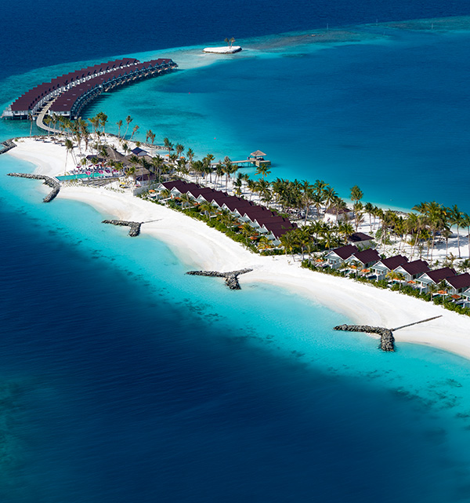
Lobigili
The Island of Love…
OBLU SELECT Lobigili is an enchanting adults-exclusive retreat amidst crystalline blue waters of Malé Atoll. In the Maldivian dialect of Dhivehi, ‘Lobi’ means love and ‘Gili’ means island. Lobigili is, in essence, the island of love.
Exclusive to OBLU SELECT Lobigili, this indulgent holiday package blends all the elements of an intimate and carefree tropical experience. Let the easy-going island rhythm seep into your soul, making way for heartfelt connections and treasured memories.

Slide 4
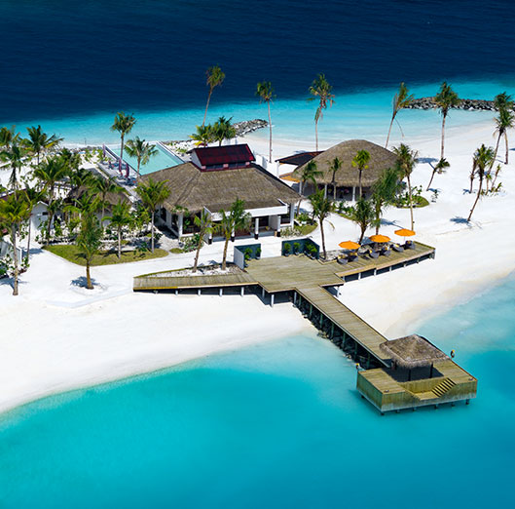
The Lobi Plan ™
Arrival & Departure Experience
Complimentary airport transfer by speedboat on arrival and departure
Lobigili island is just a 15-minutes Speedboat ride from Male’ International Airport
Upon arrival, guests are received by the airport team and escorted to the speedboat jetty for transfer
Chilled water and refreshing face towels are served at the beginning of the short journey

Slide 5
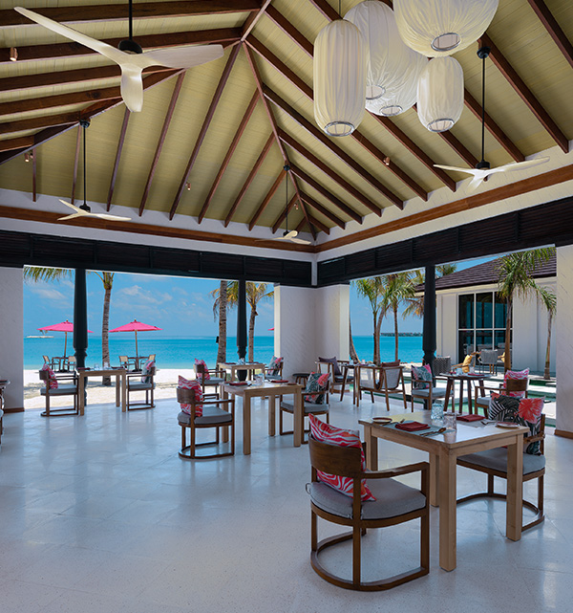
The Lobi Plan™
Dining Experiences
For a Hassle-Free Beach Holiday Experience – Let Go and Indulge in Sheer Island Bliss
Breakfast, Lunch & Dinner served at Ylang Ylang (All-Day Dining Restaurant) ;- Fresh, contemporary décor with comfortable seating overlooking the ocean. Both indoor and outdoor dining spaces and a library zone for a unique reading and dining experience. Global flavours with a spin on Italian cuisine is sure to win your taste buds over.
LUNCH: Select from a chalkboard menu with a choice of interactive live cooking stations, pizzas, tandoors, an air-conditioned salad zone and an extensive dessert bar
DINNER: Select one from a choice of five set menus: Italian, Mediterranean, Thai and Indian Indonesian menu available on request

Slide 6
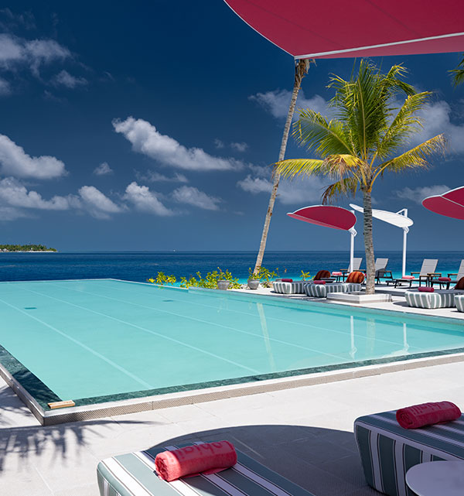
The Lobi Plan™
Dining Experiences
The Swing Bar (Pool Bar)
Vibrant beachside bar with a sprawling infinity pool, intimate cabanas, hammocks and swings – all evoking a chic European beach vibe. A glow in the golden light of the fading day, nights come alive with hypnotic DJ and Live Band performances that spark passion!
Traditional Maldivian Snacks served from 16:00 to 18:00
Selection of delicious deep-fried snacks, made from local ingredients such as coconut, onion, chili, lime, fish, and vegetables
UNLIMITED consumption of regular international brands from a selection of spirits, wines and beers
UNLIMITED orders of signature cocktails and mocktails from a menu of 10 cocktails and 10 mocktail
Choice of paid Sheesha and Cigar available for couples to enjoy at the designated smoking area on chargeable basis.

Slide 7
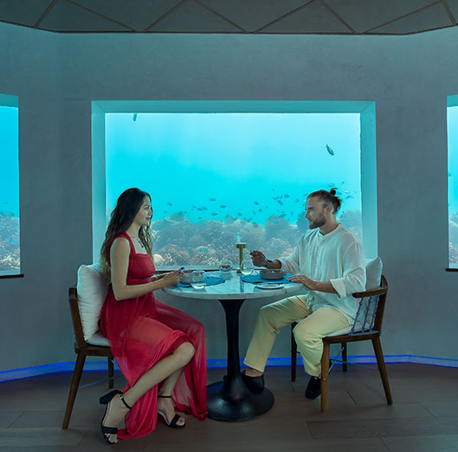
The Lobi Plan™
Specialty Dining Experiences
Only BLU (Under Ocean Restaurant) *On pre-booking, based on availability
Culinary extravaganza in a dream-like under ocean setting with window tables in this charming horseshoe-shaped restaurant. Relish impeccable modern gourmet fare and decadent desserts with a pairing of red and white wines, beer and soft beverages.
A welcome glass of sparkling wine is served on arrival, followed by a selection of the finest hot and cold appetizers served on a three-tier stackable platter.
Prix Fixe menus with the option of Meat, Seafood or Vegetarian ONE COMPLIMENTARY specialty dining experience per guest for EVERY FOUR-NIGHTS of stay

Slide 8
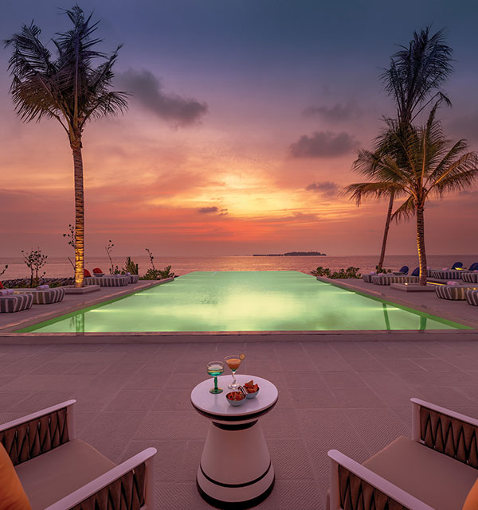
The Lobi Plan™
Specialty Dining Experiences
Gaadiya-17 Food Truck *On pre-booking, based on availability
A casual dining option under the sky, on-board menu served on the beach side with sand under your feet. Offering a three-course meal featuring grilled meats and seafood options.
DAILY changing starter, one Main Course with side dish and sauce, followed by dessert
Selection of paired wines, beers and soft beverages
ONE COMPLIMENTARY dining experience under the Lobi Plan™ per guest for EVERY FOUR-NIGHTS of stay (on pre-booking, based on availability)
** Exclusive Lobster Night every Wednesday on Chargeable basis

Slide 9
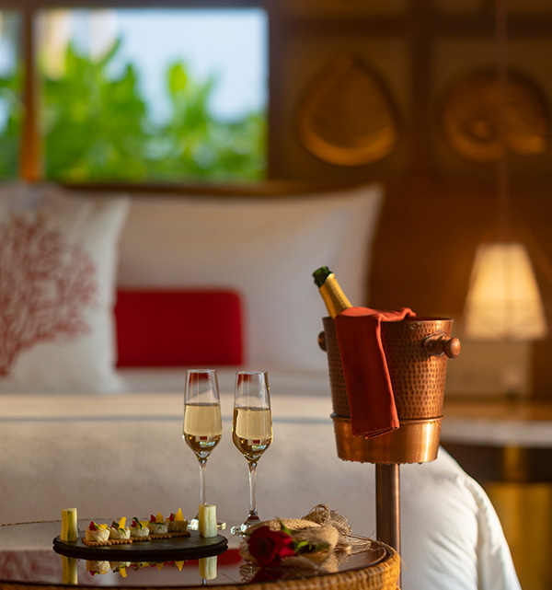
The Lobi Plan™
Beverages
UNLIMITED orders from a wide selection of liquor at Ylang Ylang and The Swing Bar
Wide selection of premium wines and sparkling wines from the world-over
UNLIMITED orders of Signature Cocktails from a selection of:
10 Cocktails and 10 Mocktails at The Swing Bar
Soft drinks, mineralized water, and an assortment of tea and coffee available at all outlets

Slide 10
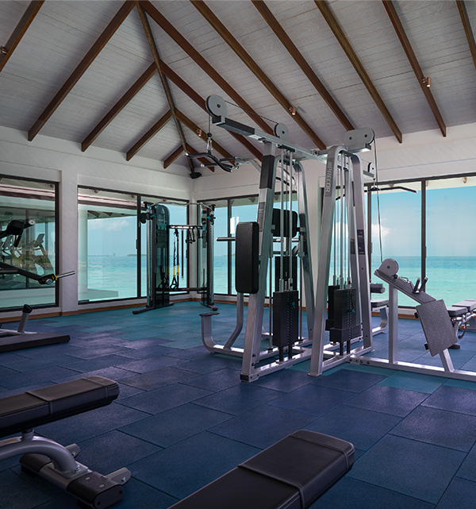
The Lobi Plan™
Activities & Adventure
ENTERTAINMENT
DAILY live music performances at The Swing Bar
GYM AND RECREATION
UNLIMITED access to our fully equipped over water gymnasium
SNORKELLING AND WATER SPORTS
COMPLIMENTARY use of snorkelling equipment throughout the stay
COMPLIMENTARY use of non-motorized water sports equipment (Stand-Up Paddle Board and Kayak)
EXCURSIONS
ONE COMPLIMENTARY Sunset Fishing per guest during stay
ONE COMPLIMENTARY Snorkeling guide trip per guest during stay
** Weather permitting

Slide 11
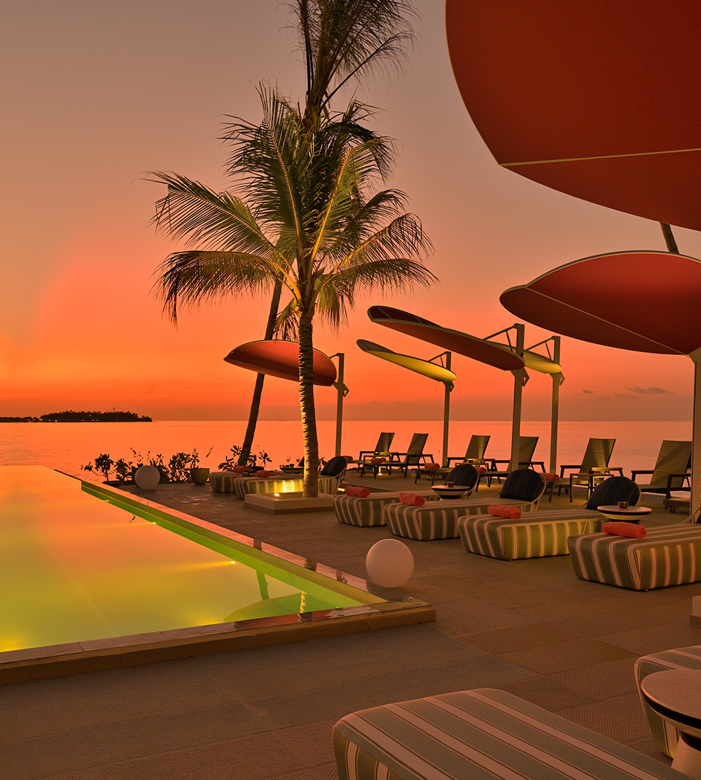
The Lobi Plan™
Other Services
IN VILLA MINIBAR
Replenished DAILY with an assortment of alcoholic and non-alcoholic beverages along with a selection of snacks
SPA
ELE|NA THE SPA offers a range of holistic treatments inspired by natural elements, that nourish the mind, body, and soul.
Eligible per person per stay depending on the duration of the stay:
Minimum 4 nights stay: ONE 45 minutes spa treatment

Slide 12
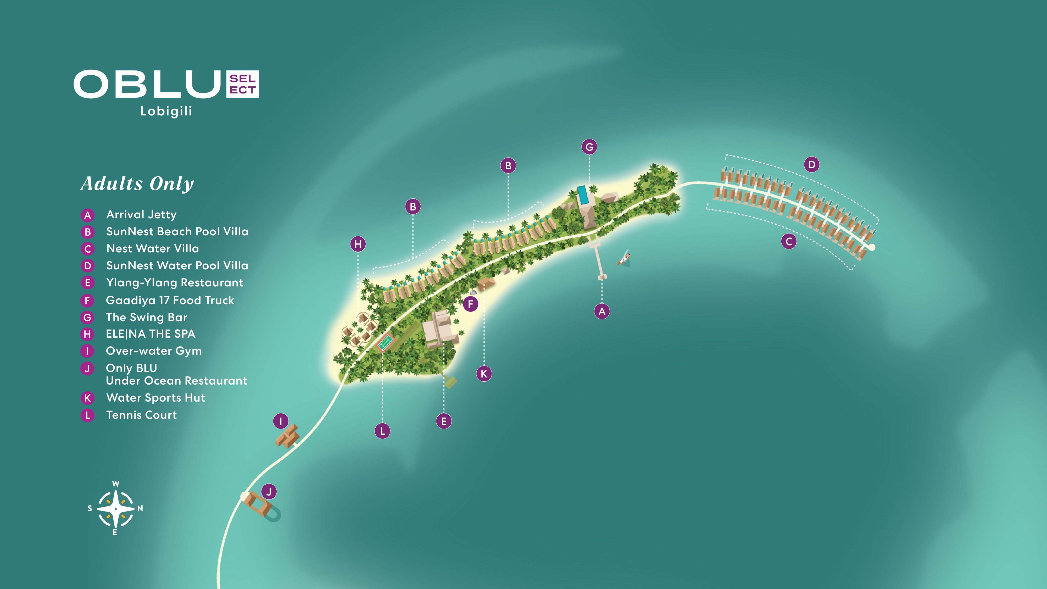

Slide 13
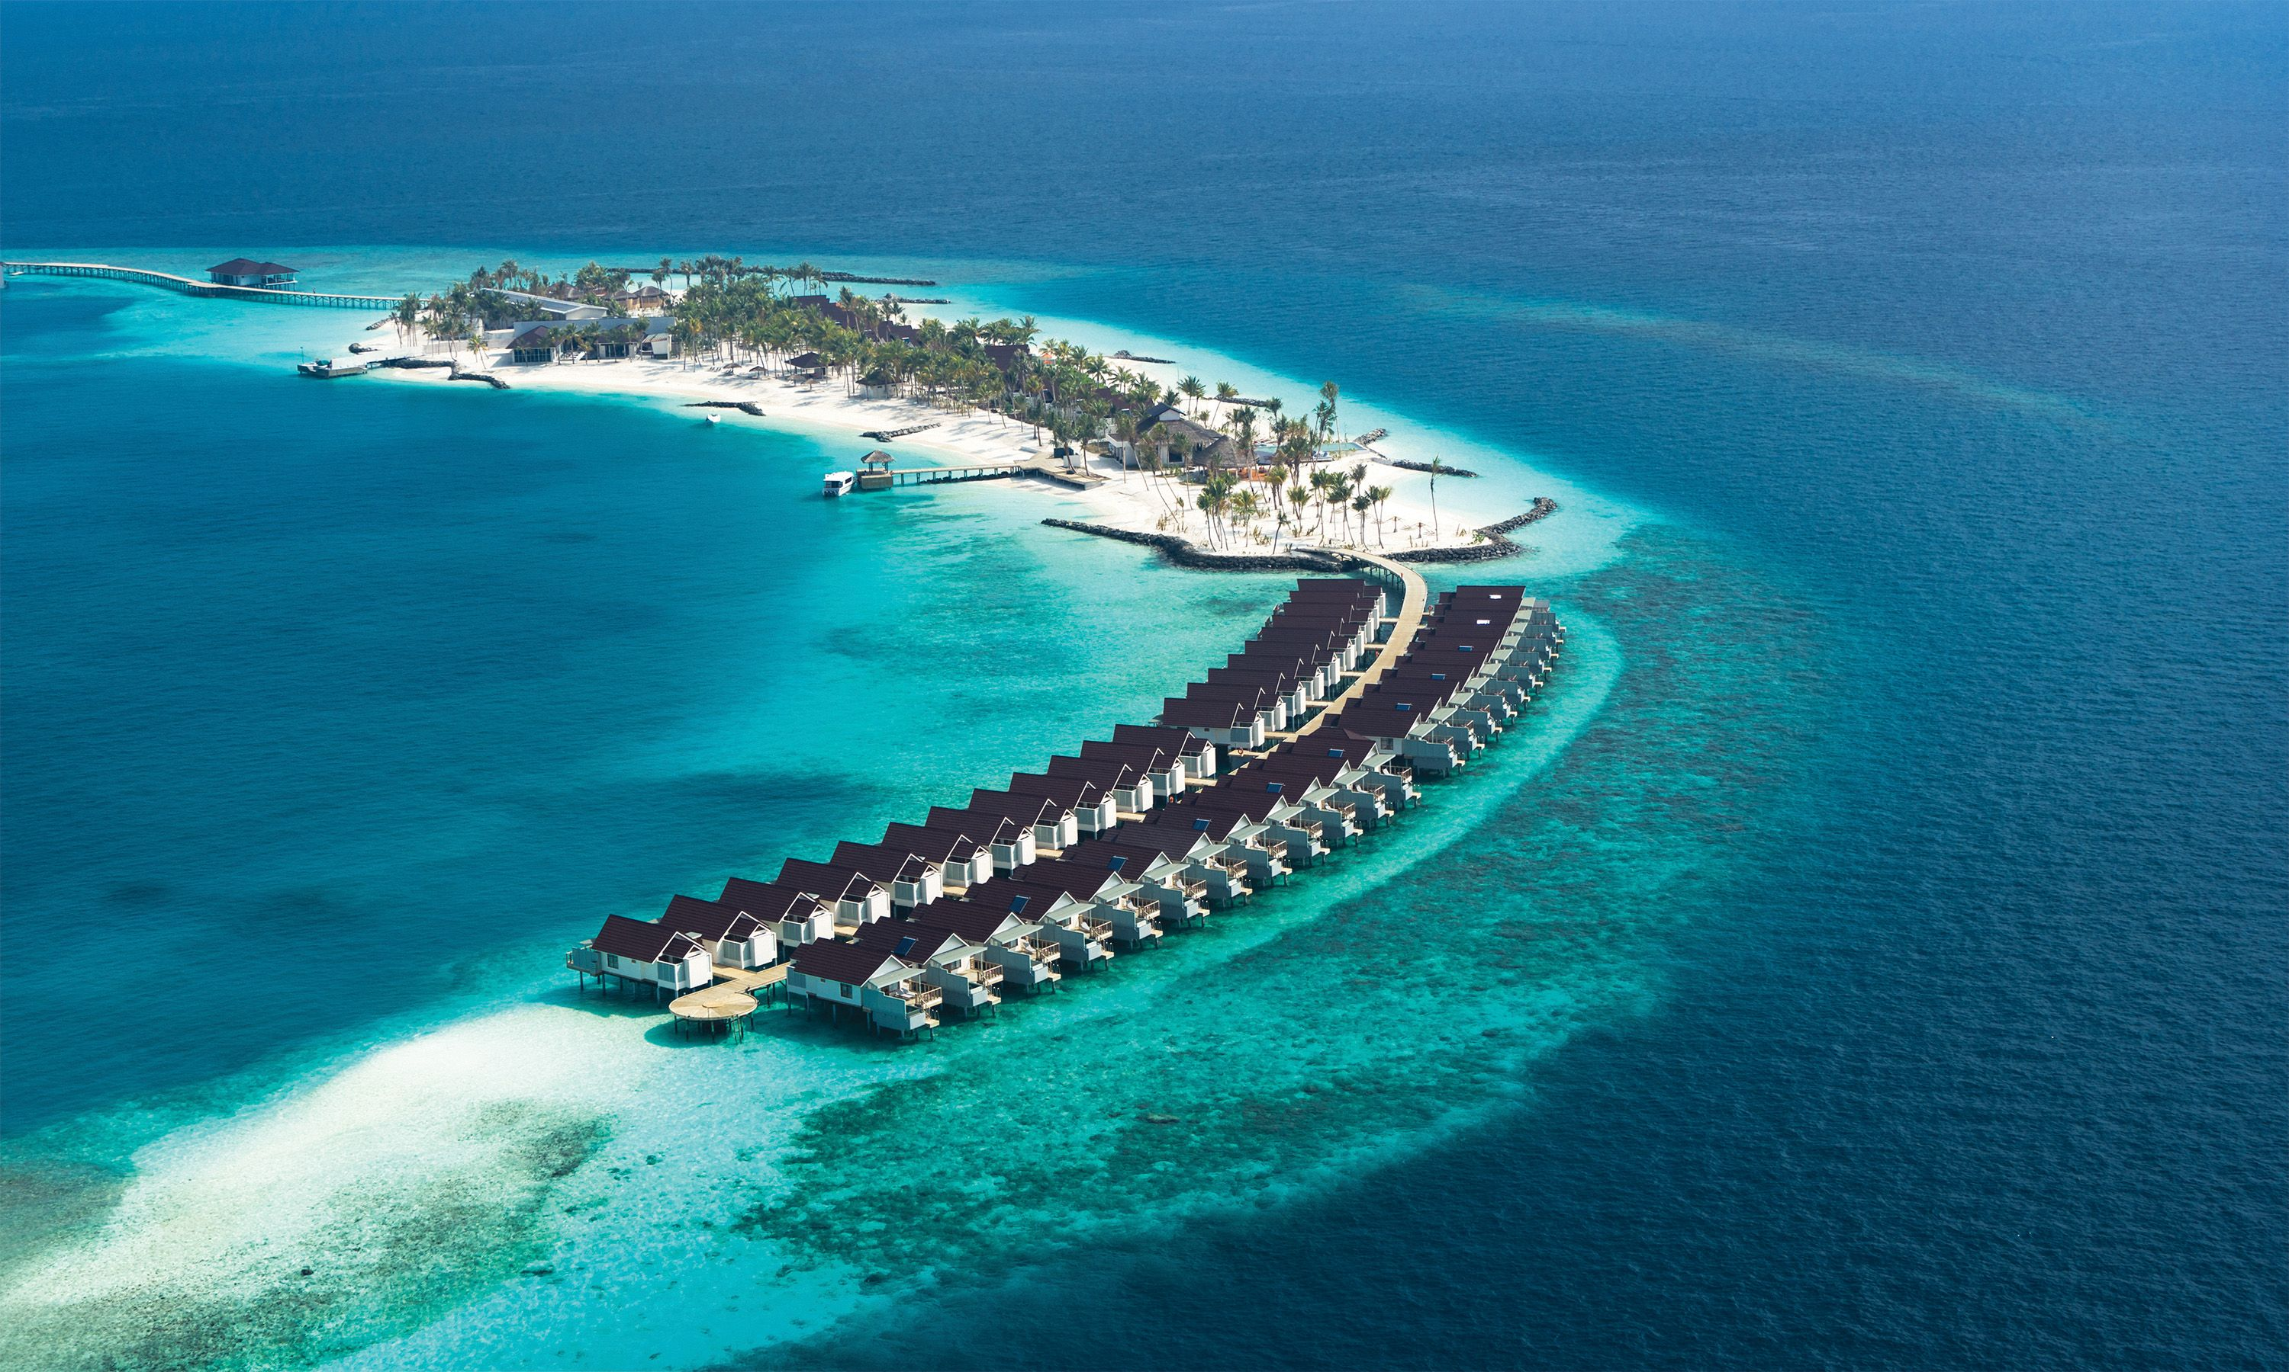
Full Island Aerial View

Slide 14
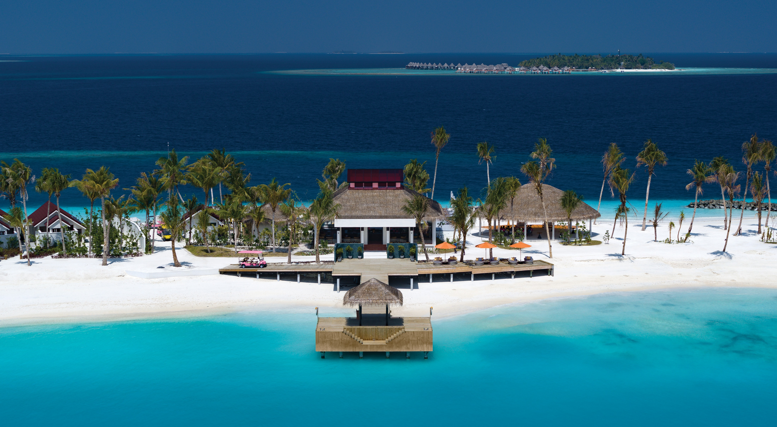
Island and Arrival Jetty

Slide 15
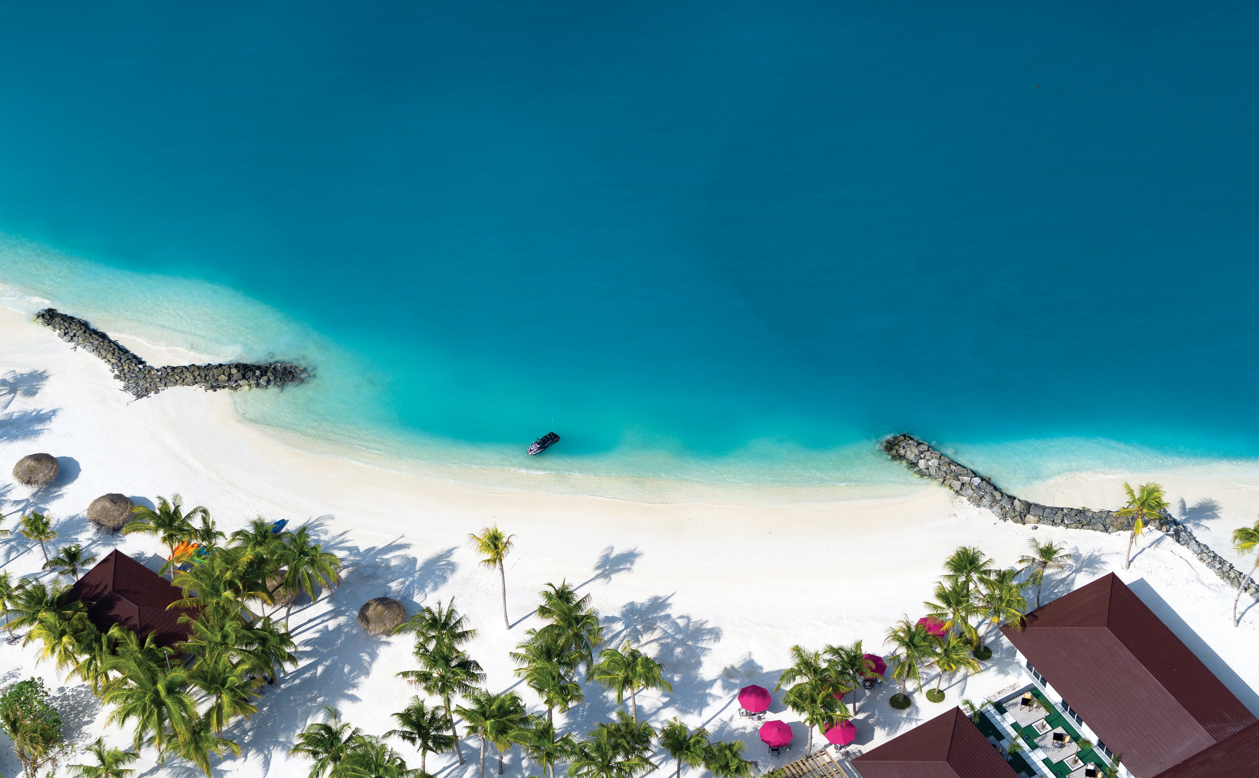
SunNest Beach Villas – Eastern Beach Aerial View

Slide 16
SunNest Beach Pool Villa

Slide 17
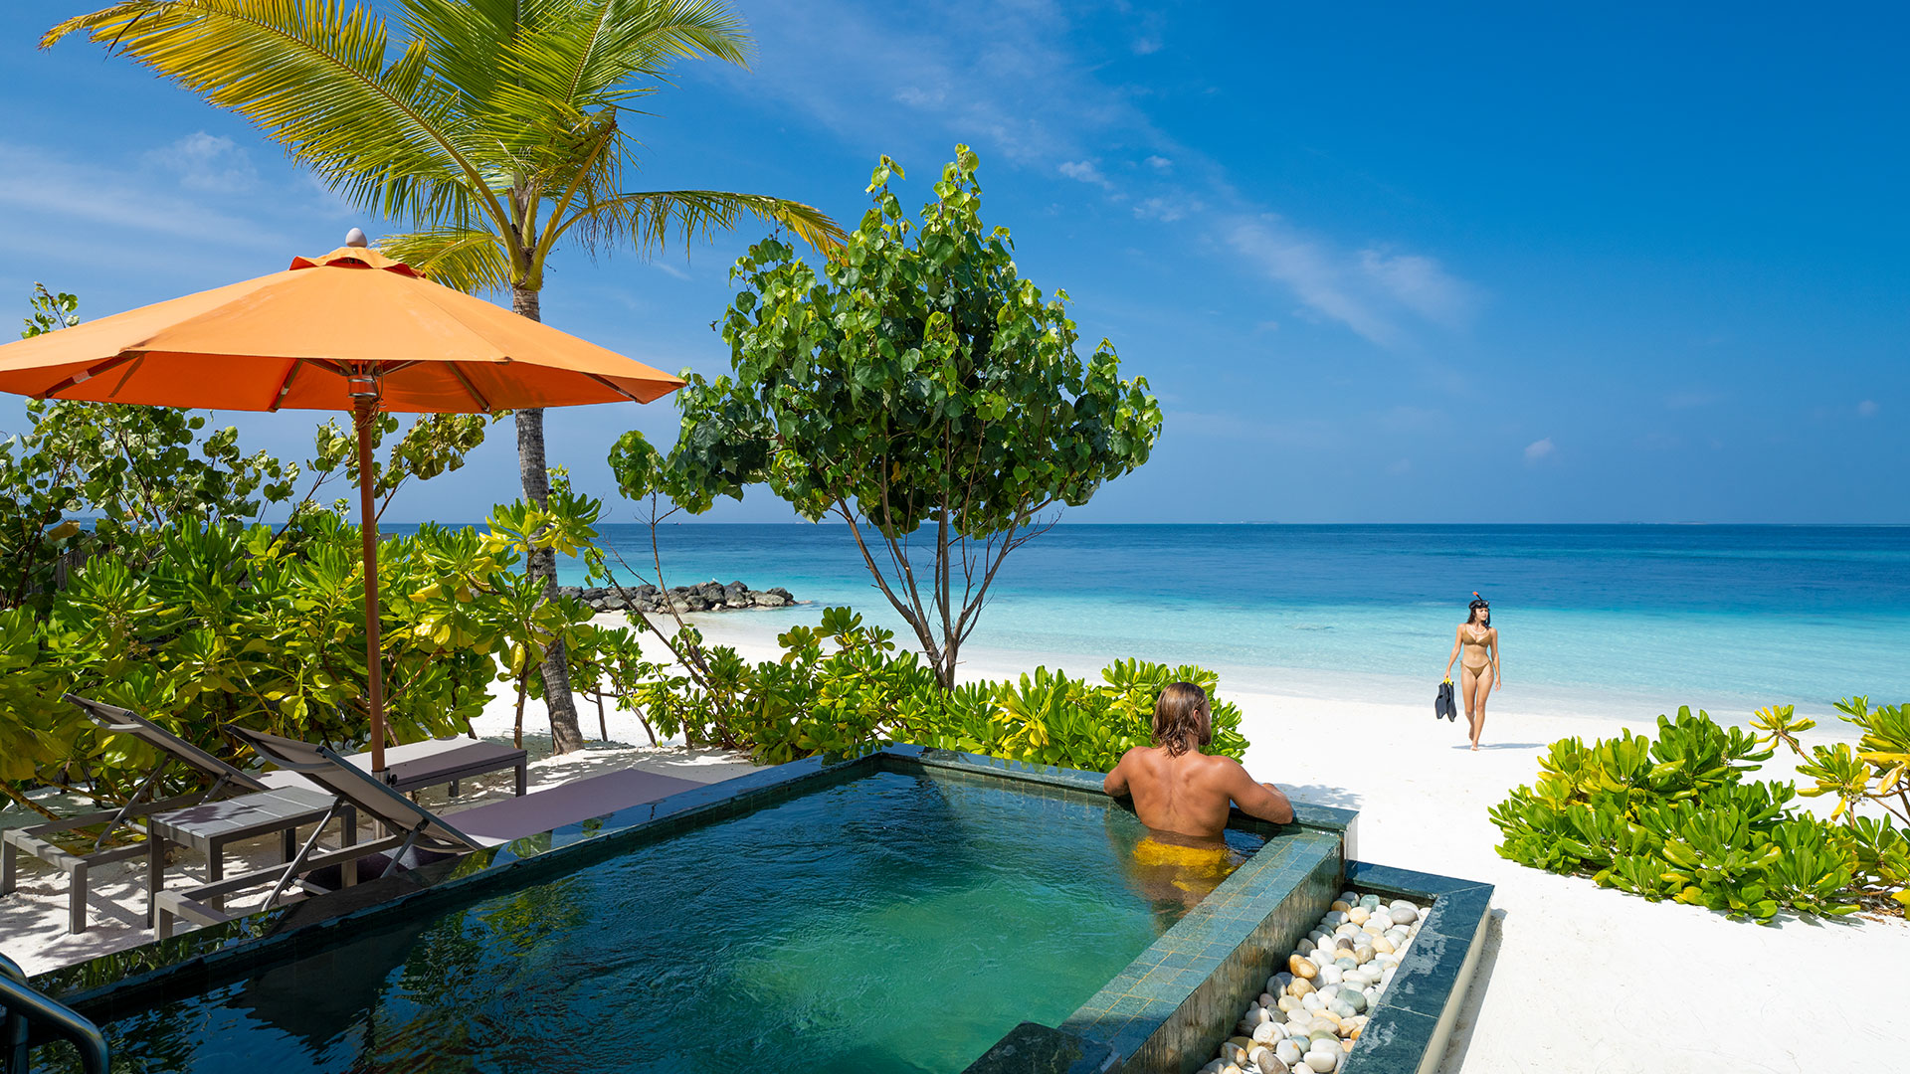
SunNest Beach Pool Villa – Pool & Beach View

Slide 18
SunNest Beach Pool Villa - Bedroom

Slide 19
SunNest Beach Pool Villa – Bathroom

Slide 20
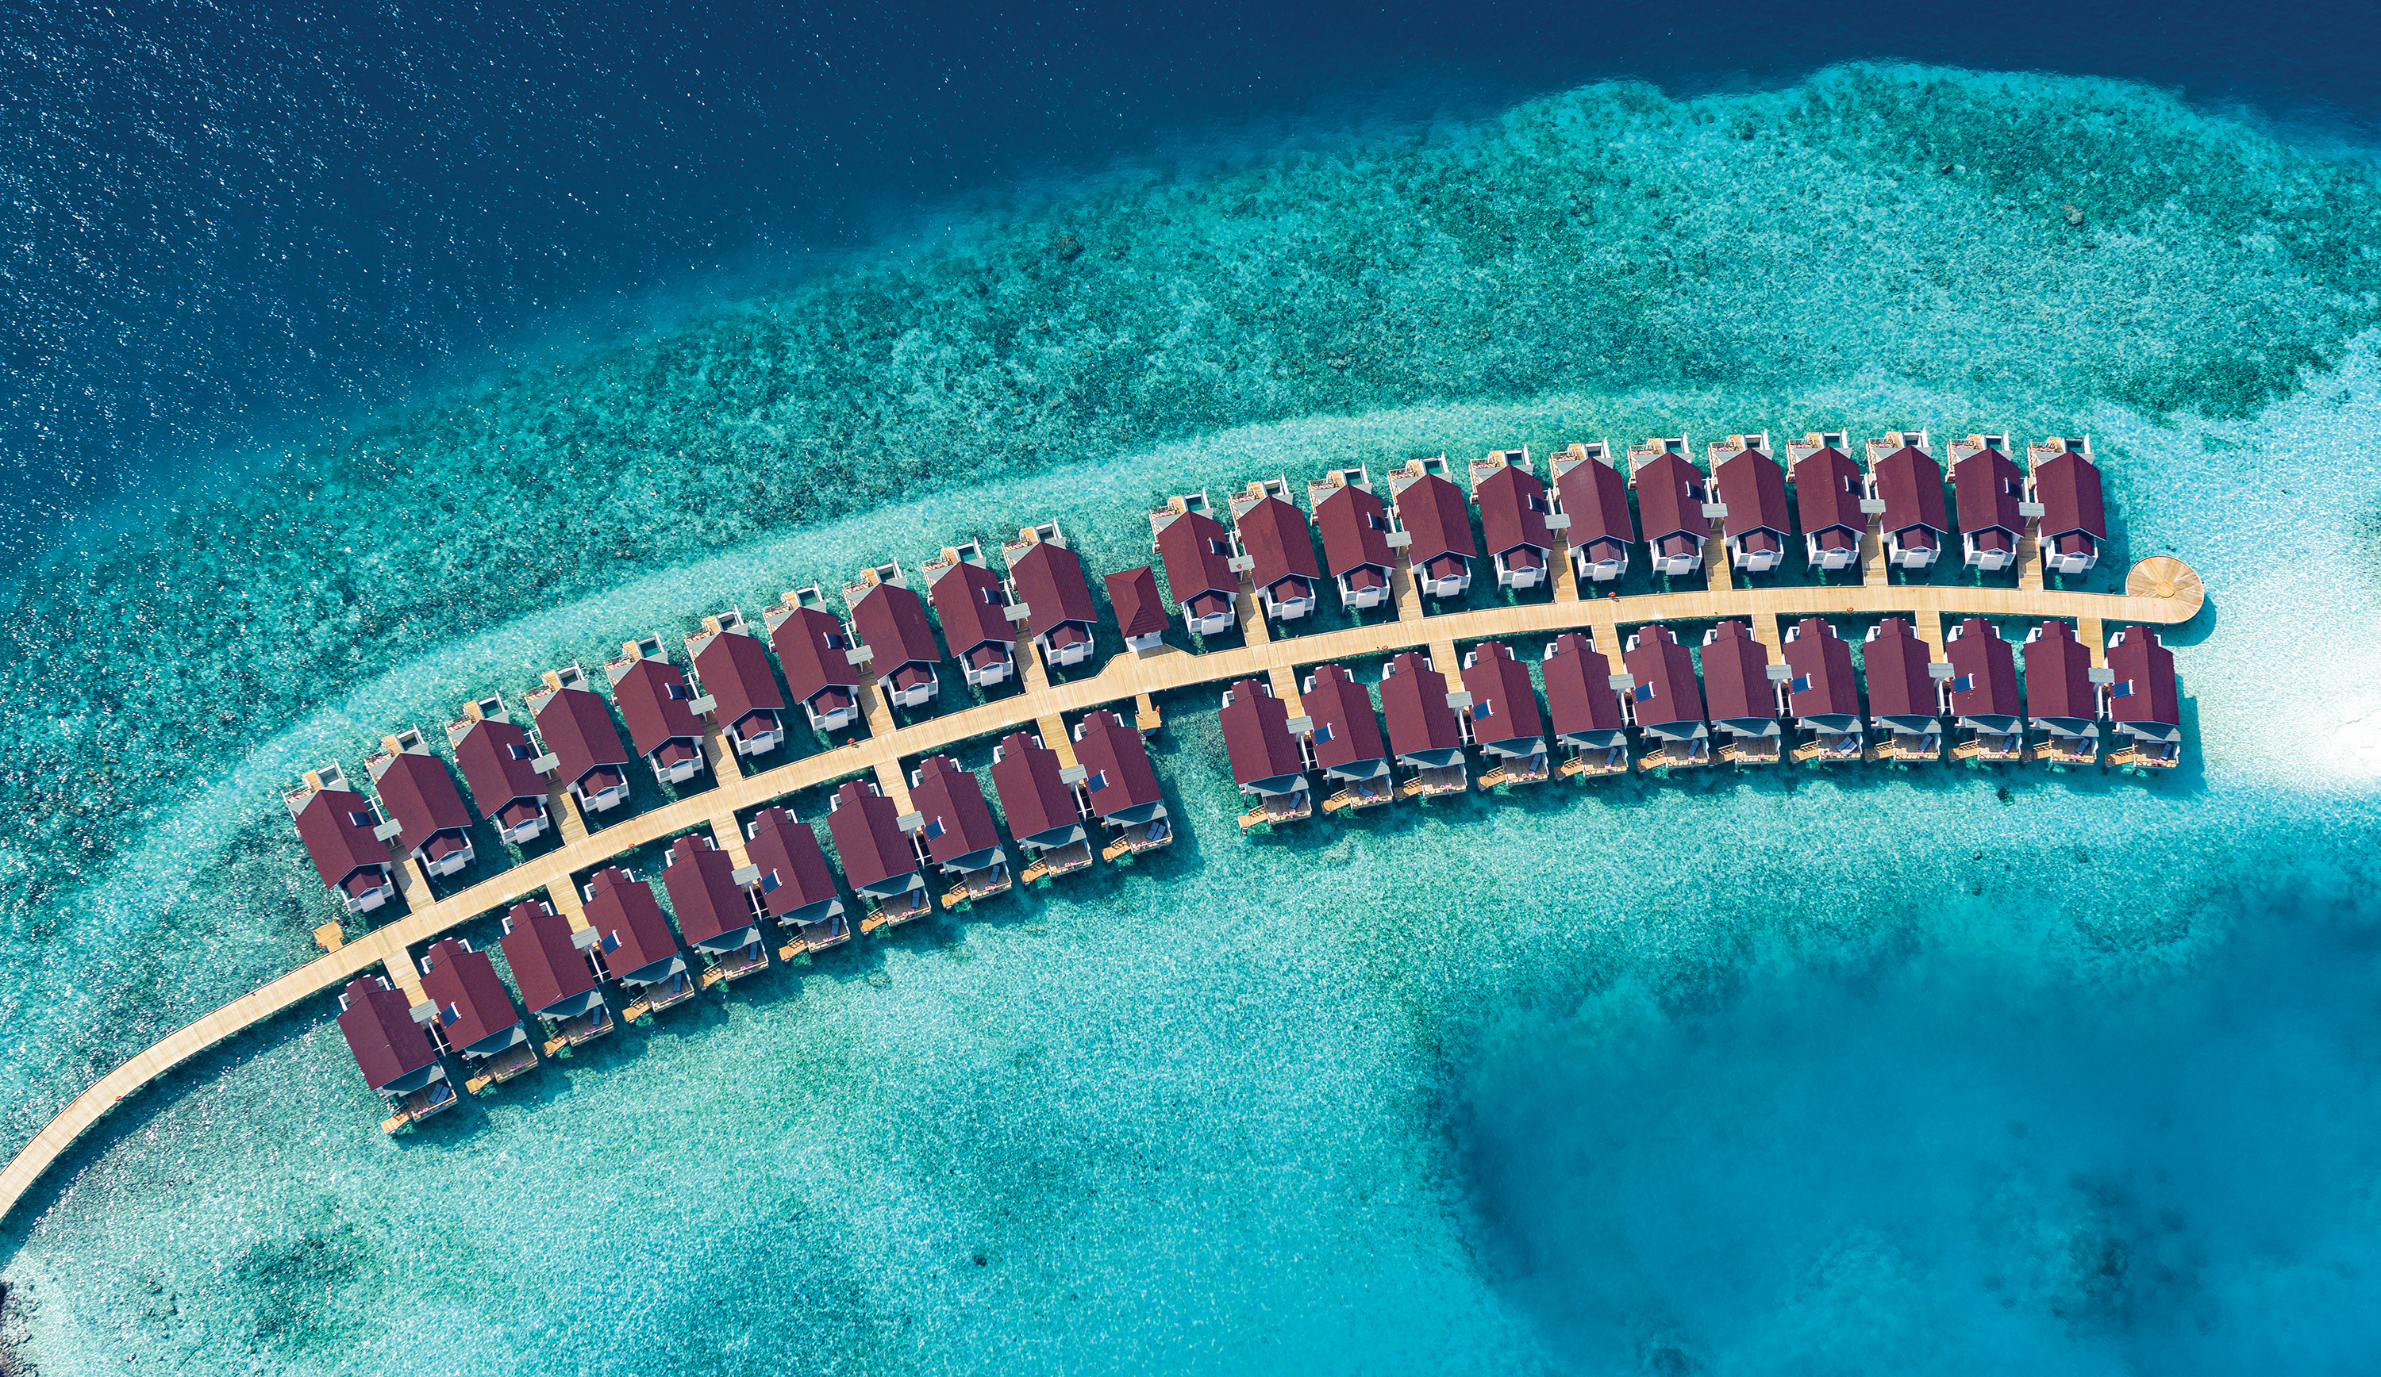
Water Villa – Aerial View

Slide 21
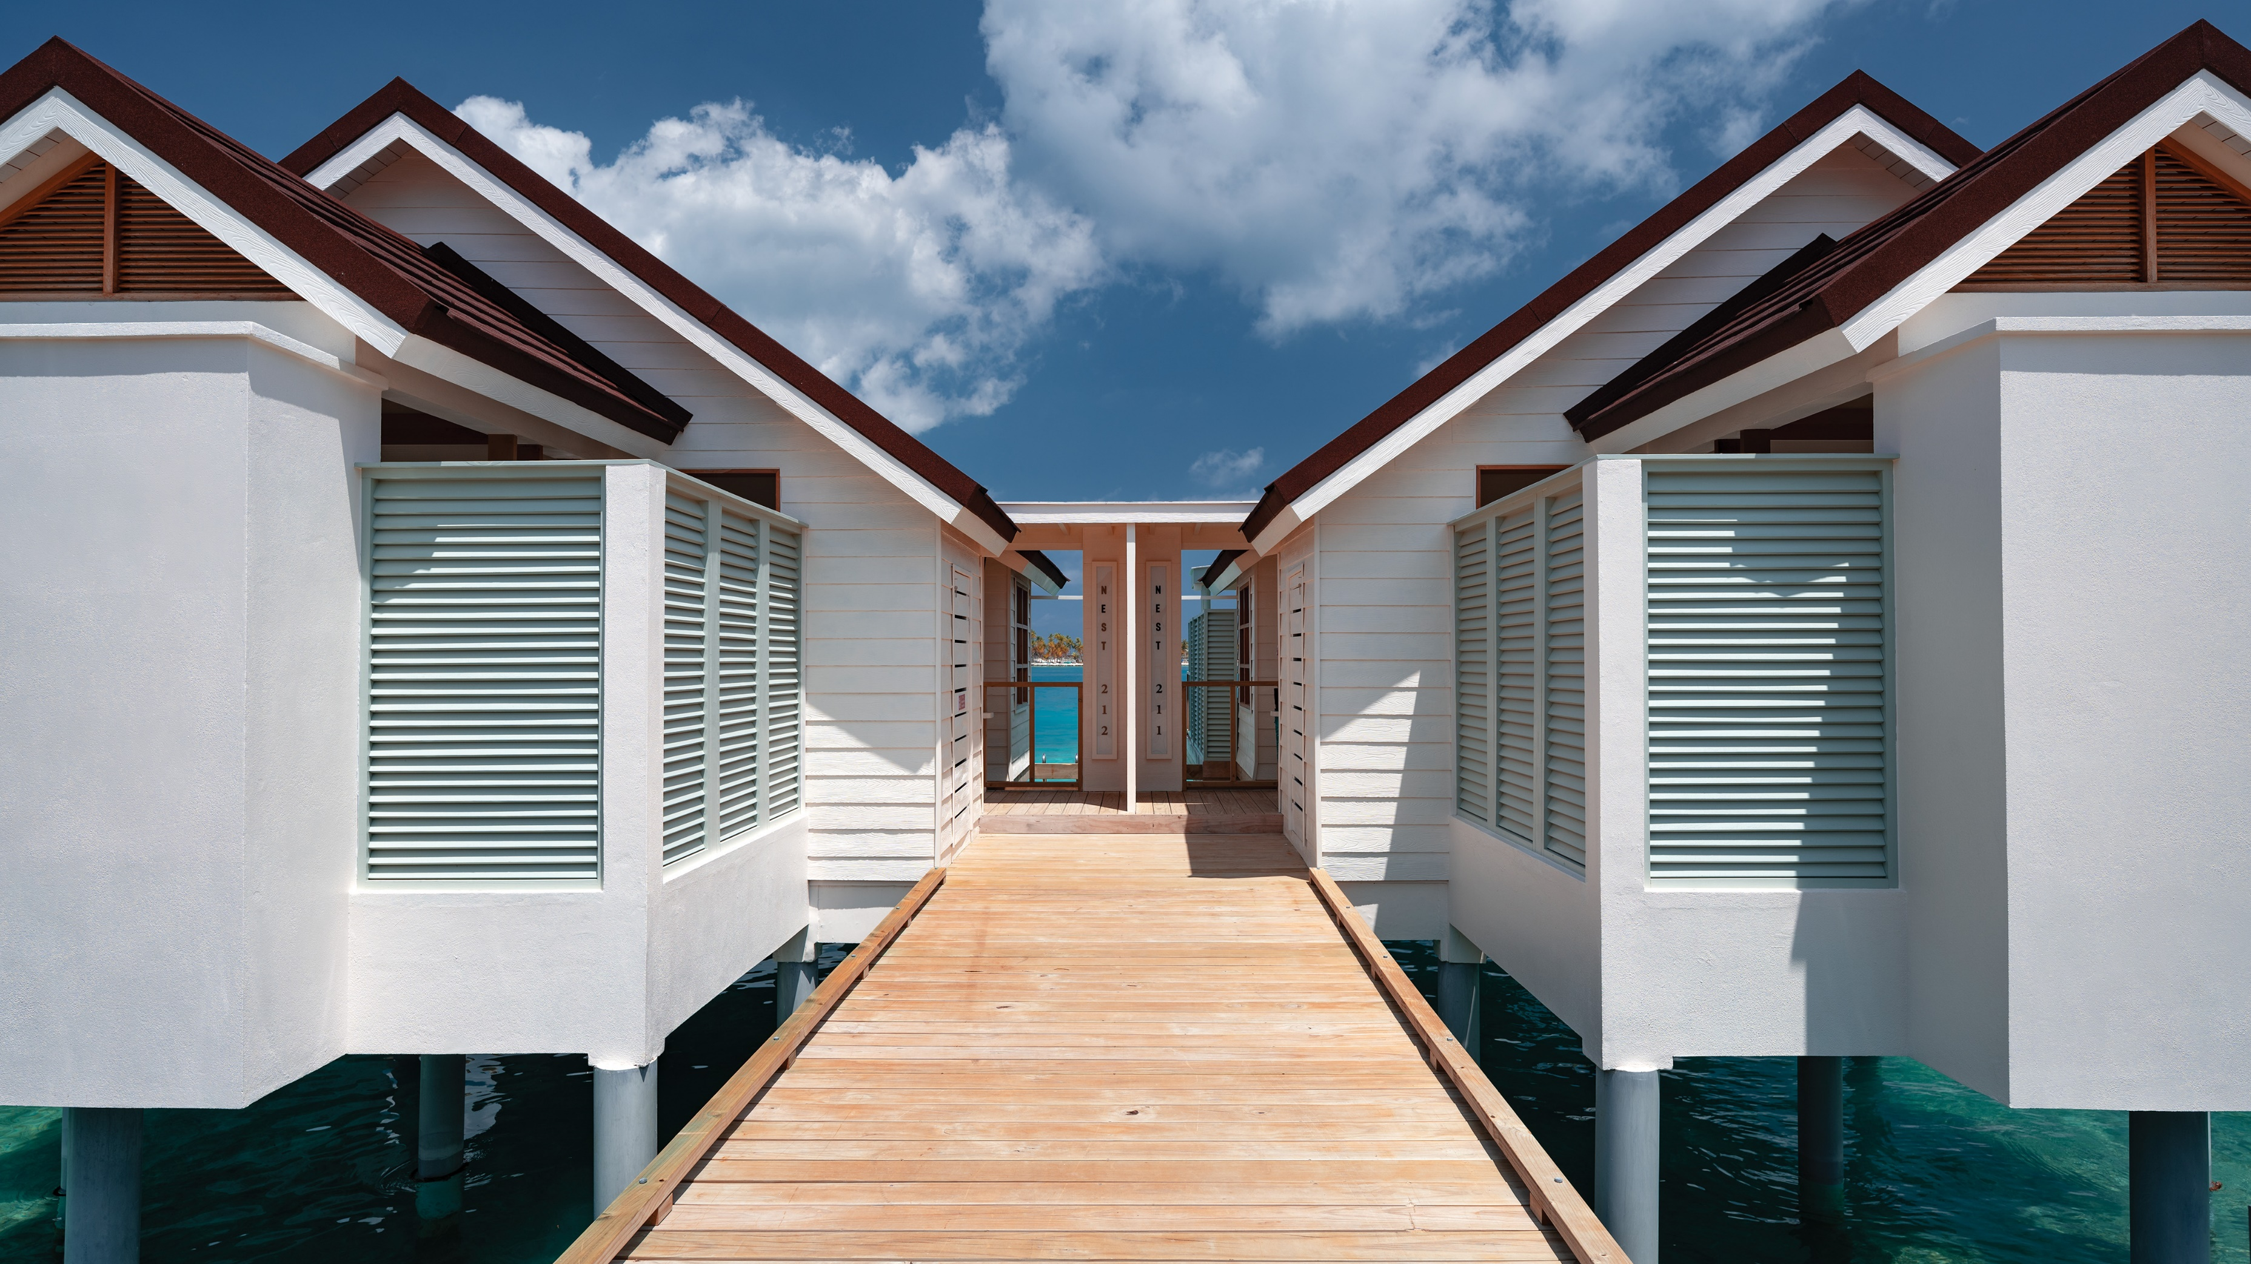
Water Villa – Entrance

Slide 22
SunNest Water Villa & Nest Water Villa – Bedroom Interior with Sea View

Slide 23
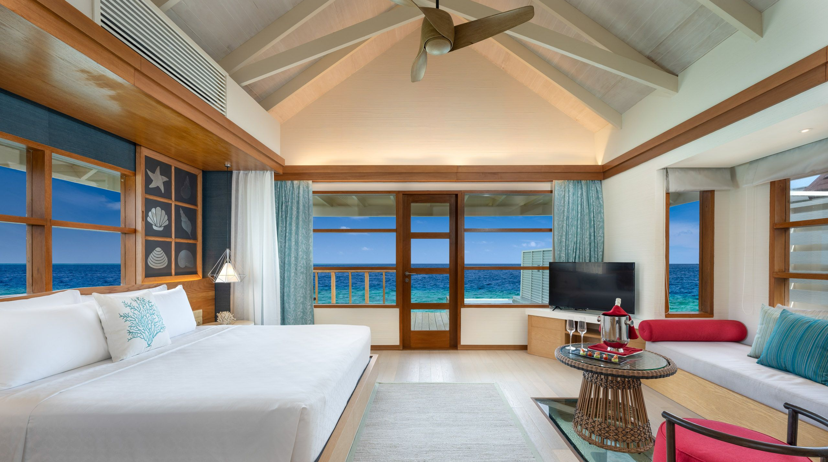
SunNest Water Villa & Nest Water Villa – Bedroom & Ocean view

Slide 24
SunNest Water Villa & Nest Water Villa – Interior view
SunNest Beach Pool Villa

Slide 25
SunNest Water Villa & Nest Water Villa - Bathroom

Slide 26
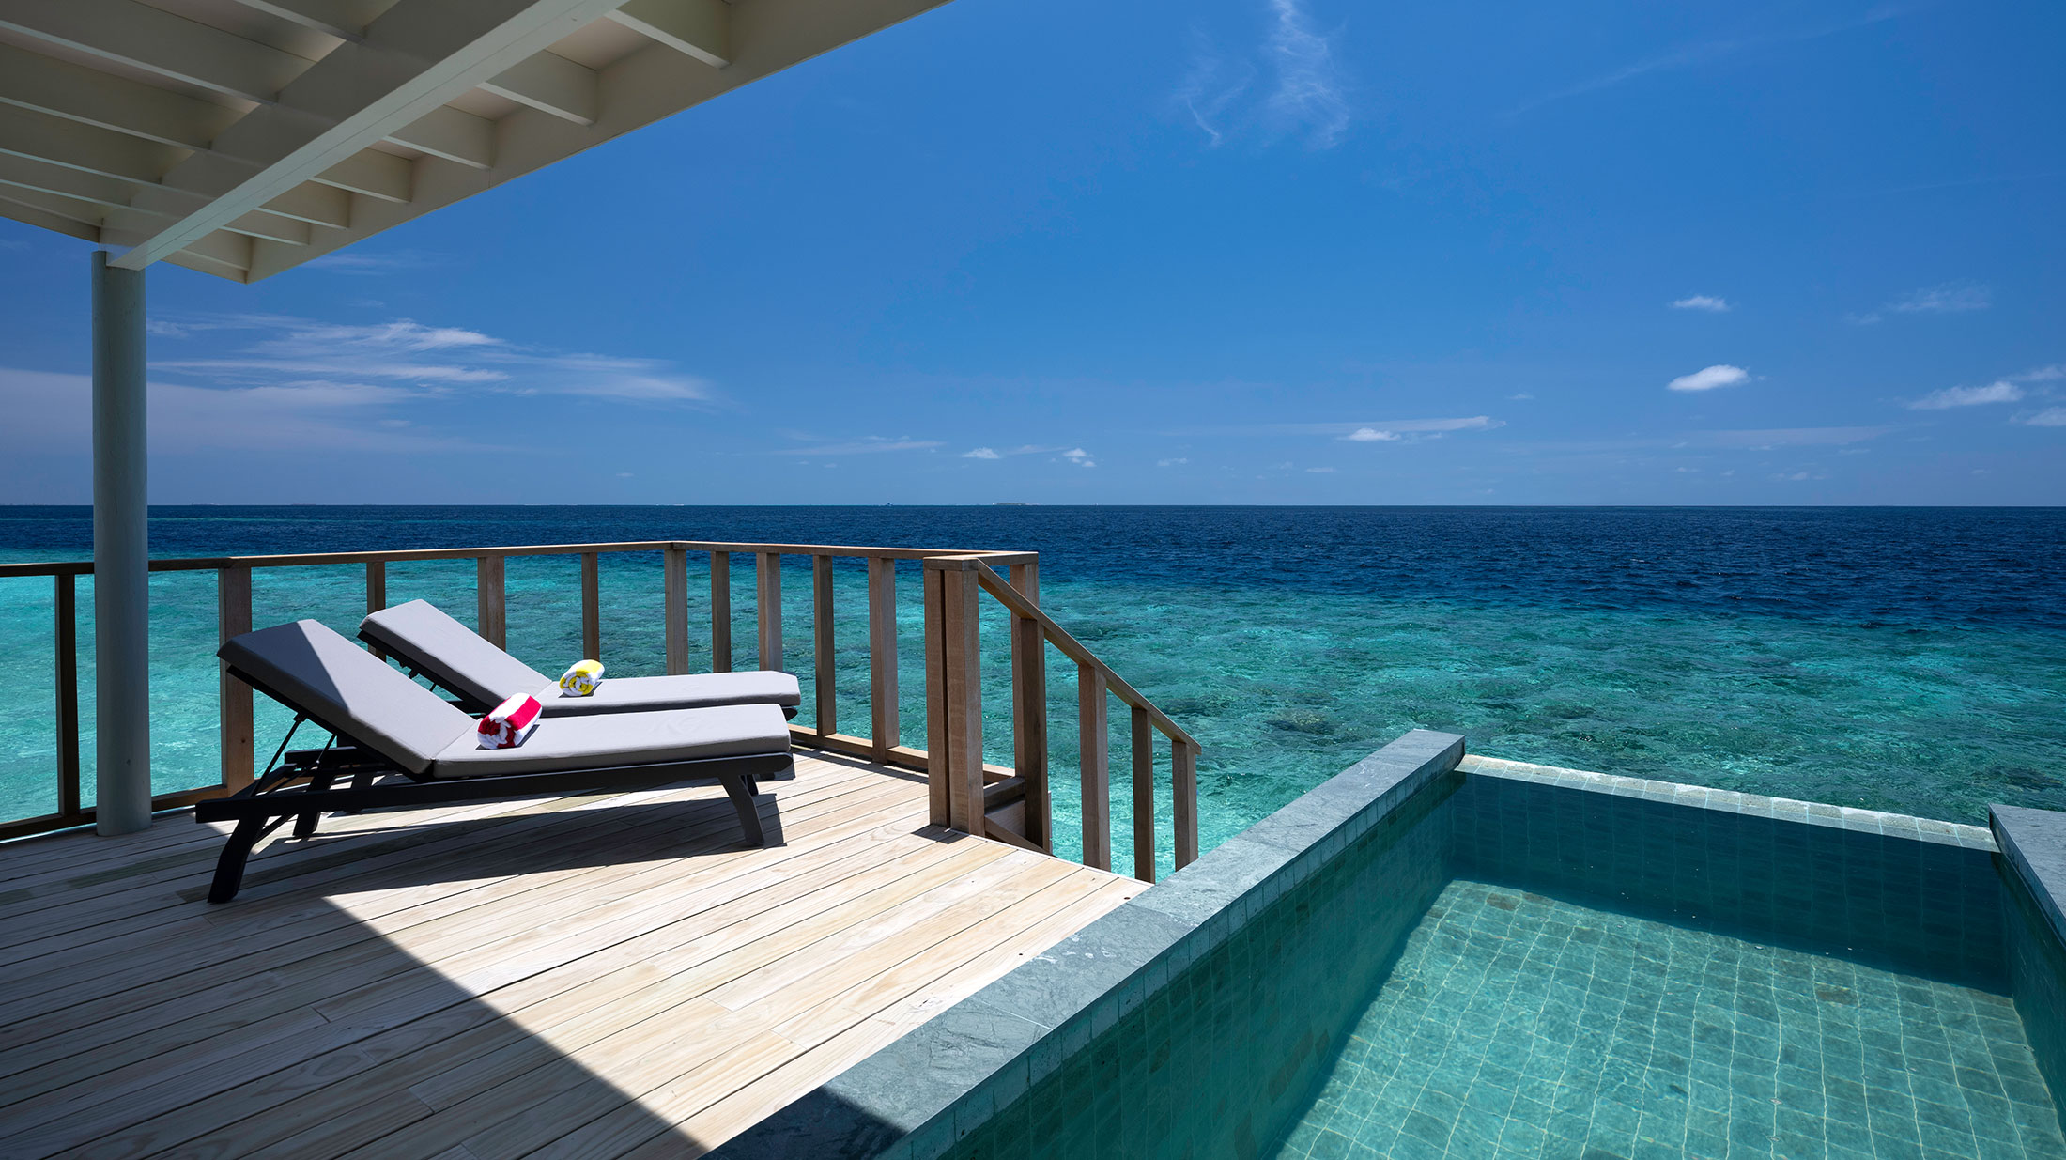
SunNest Water Villa & Nest Water Villa with Pool – Deck View

Slide 27
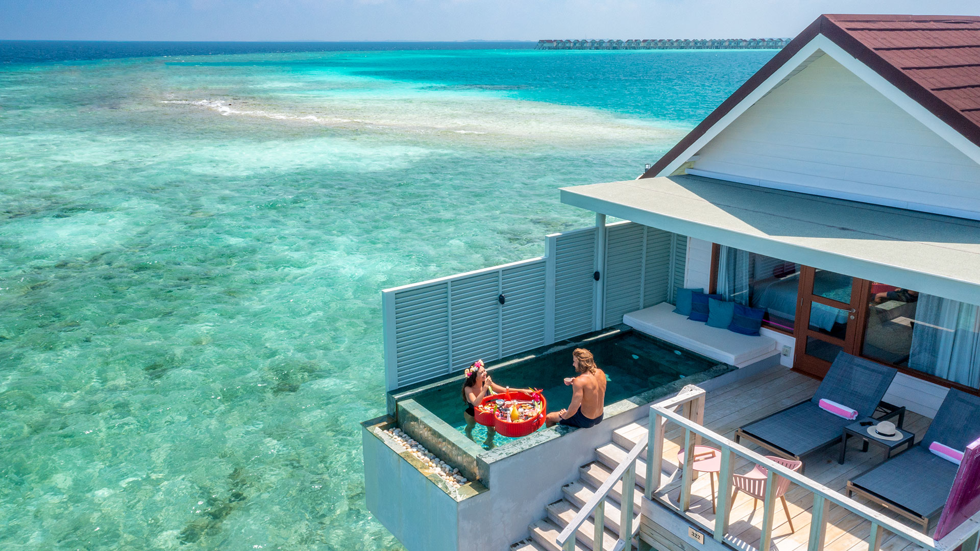
Floating Breakfast

Slide 28
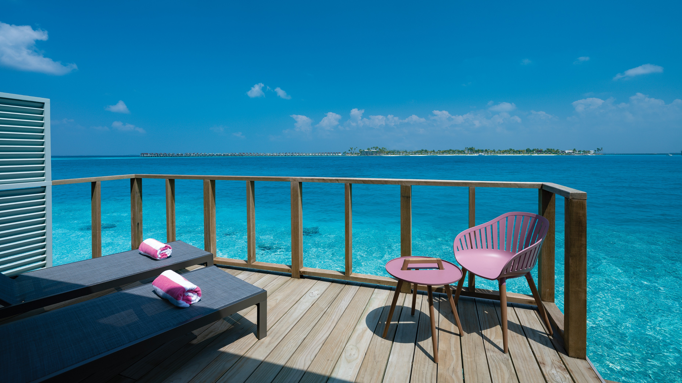
SunNest Water Villa without Pool – Deck View

Slide 29
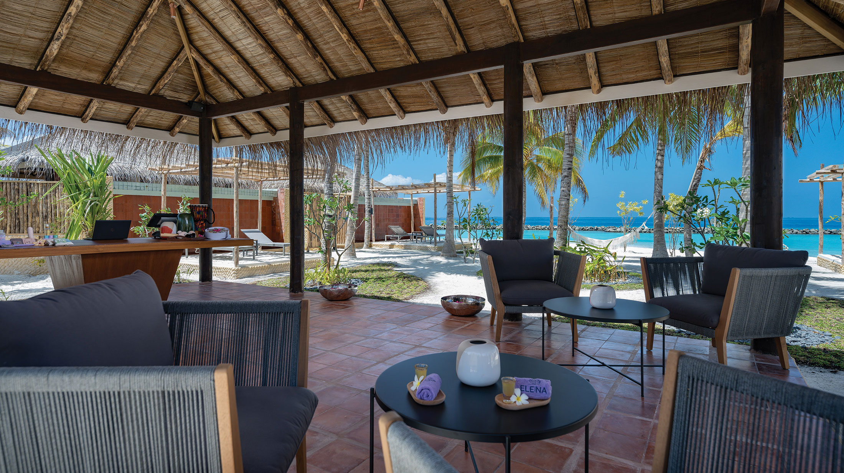
ELENA Spa – Entrance

Slide 30
ELENA Spa

Slide 31
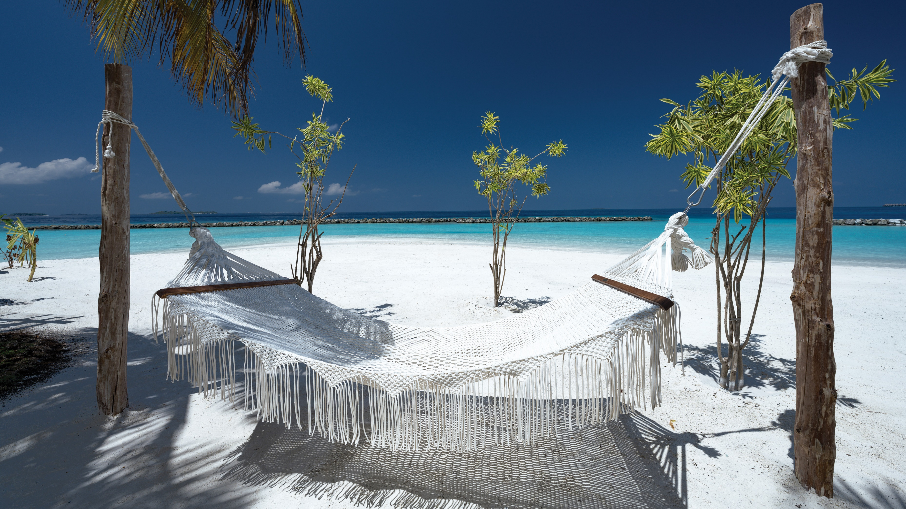
ELENA Spa – Beach Hammock

Slide 32
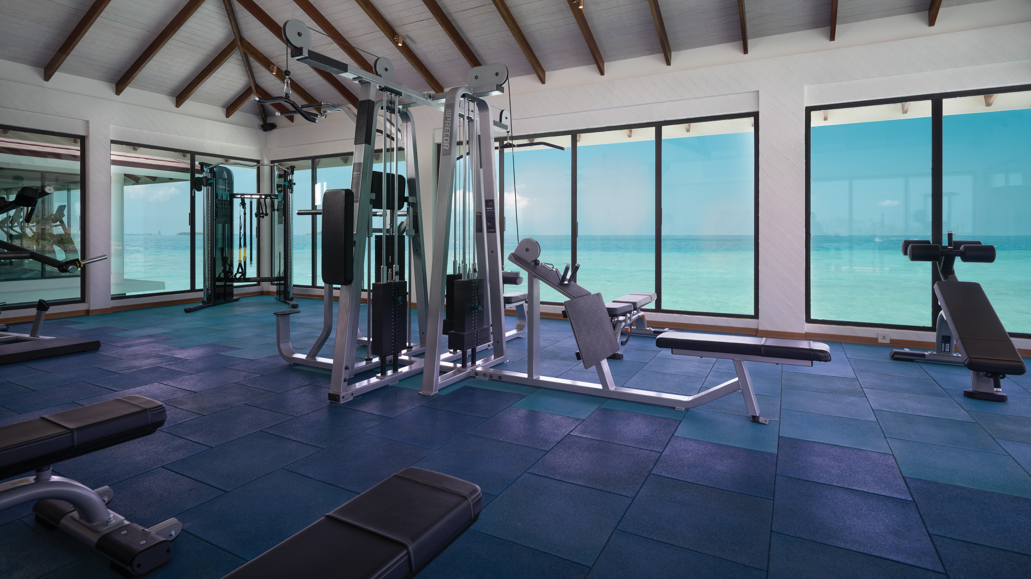
Overwater Gym

Slide 33
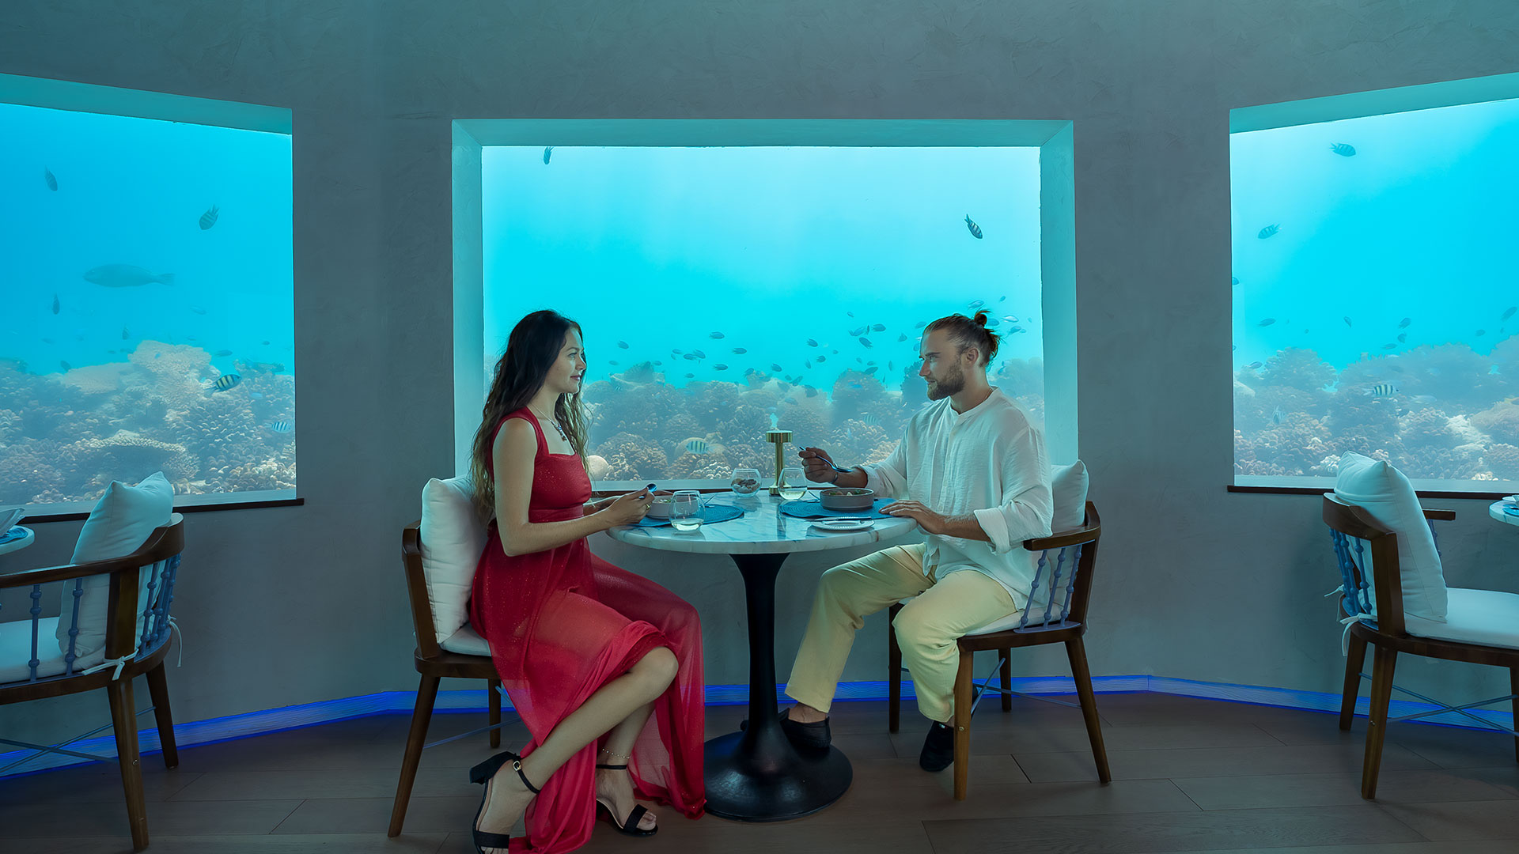
Only BLU Under Ocean Restaurant

Slide 34
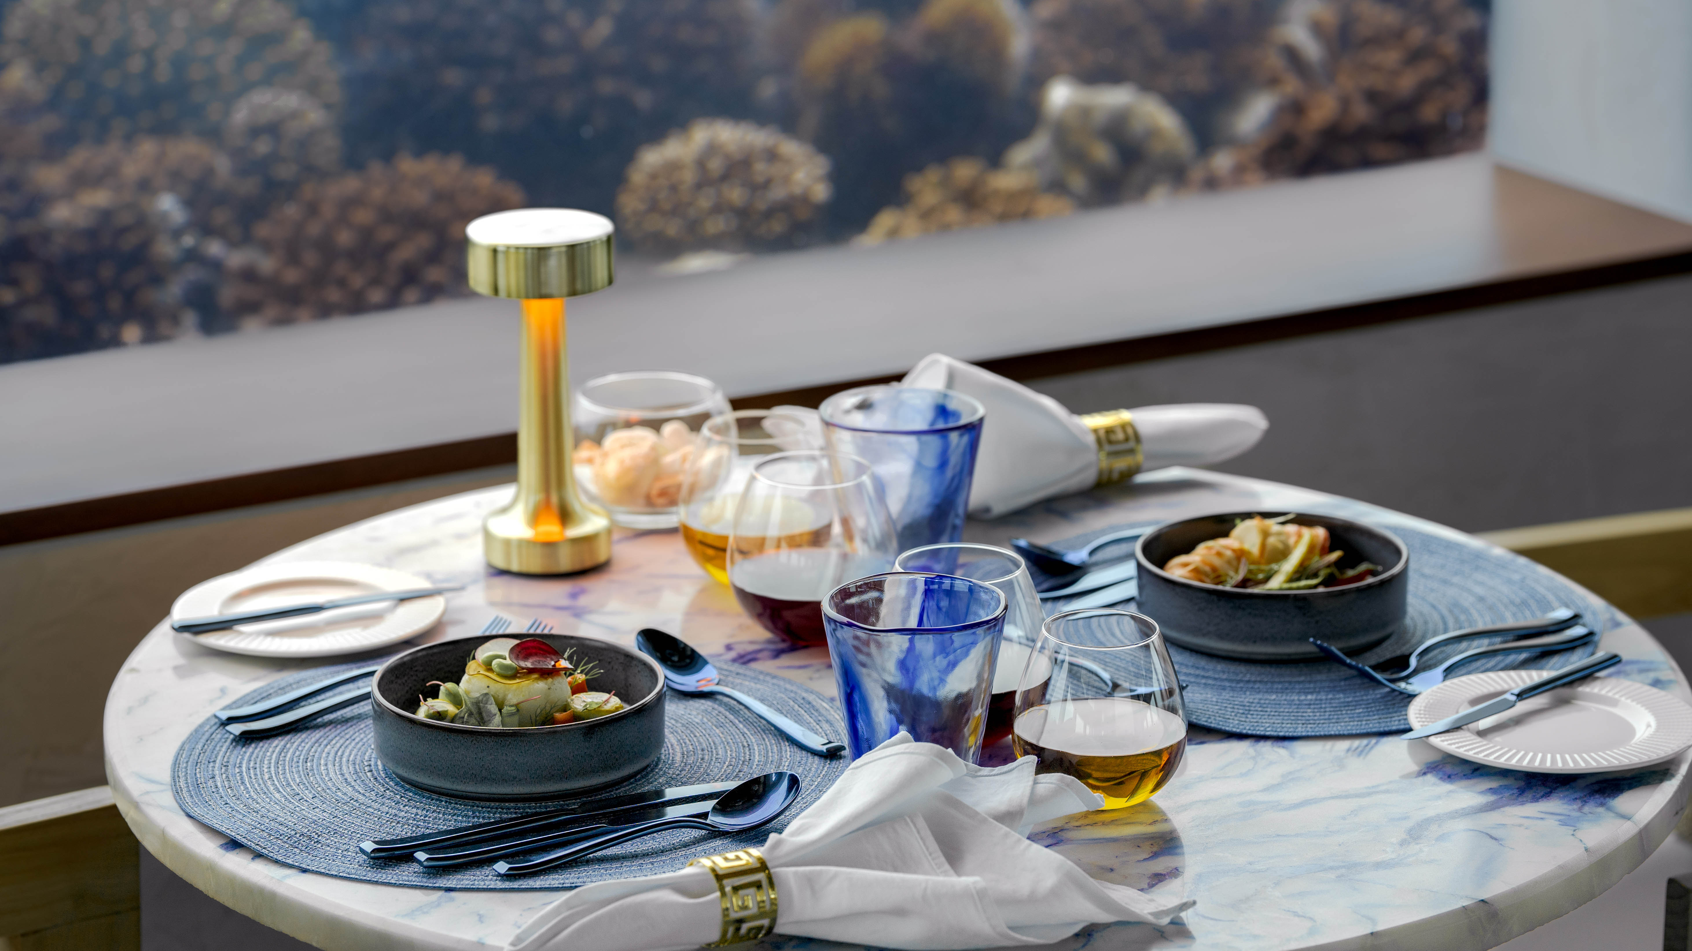
Only BLU Under Ocean Restaurant – Table Set Up

Slide 35
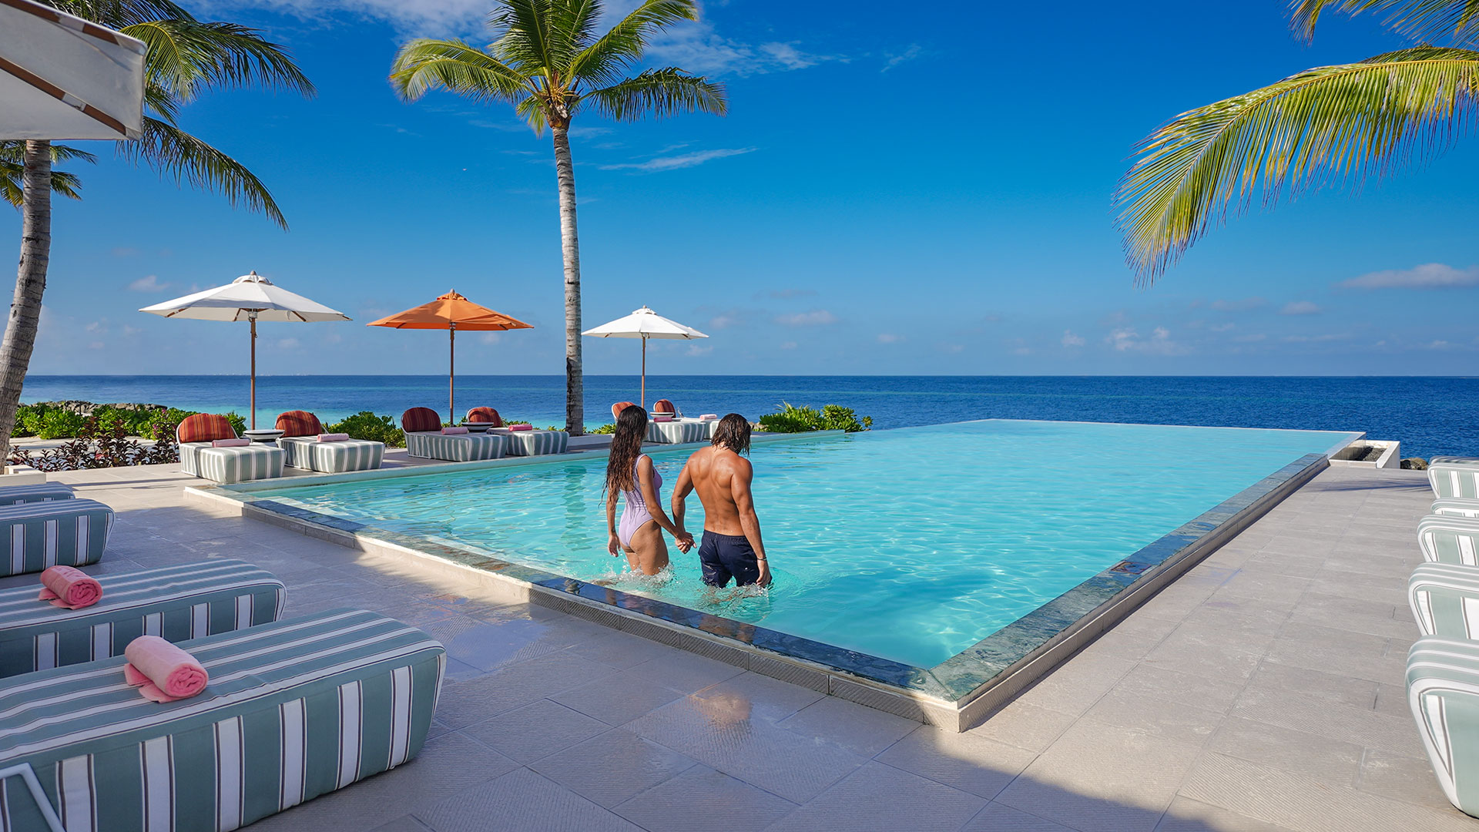
Swing Bar - Pool

Slide 36
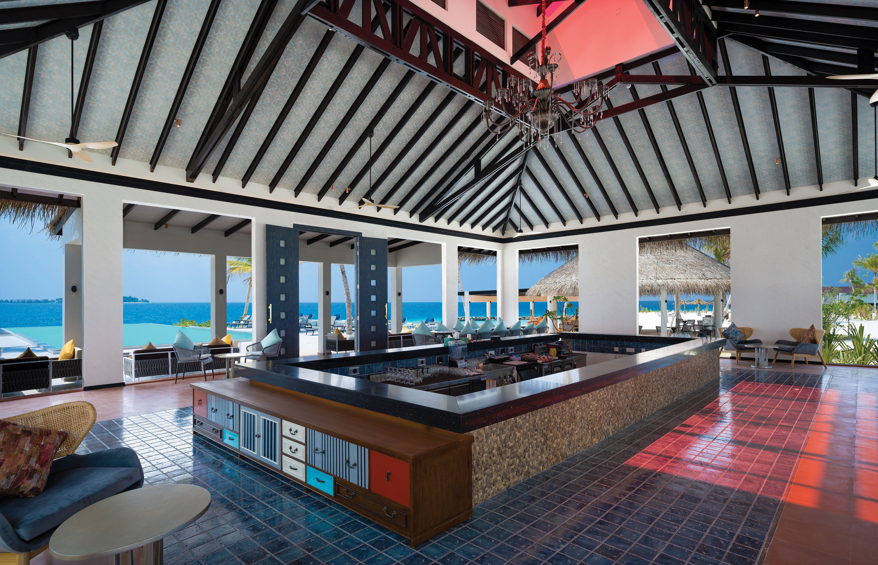
Swing Bar - Interior

Slide 37
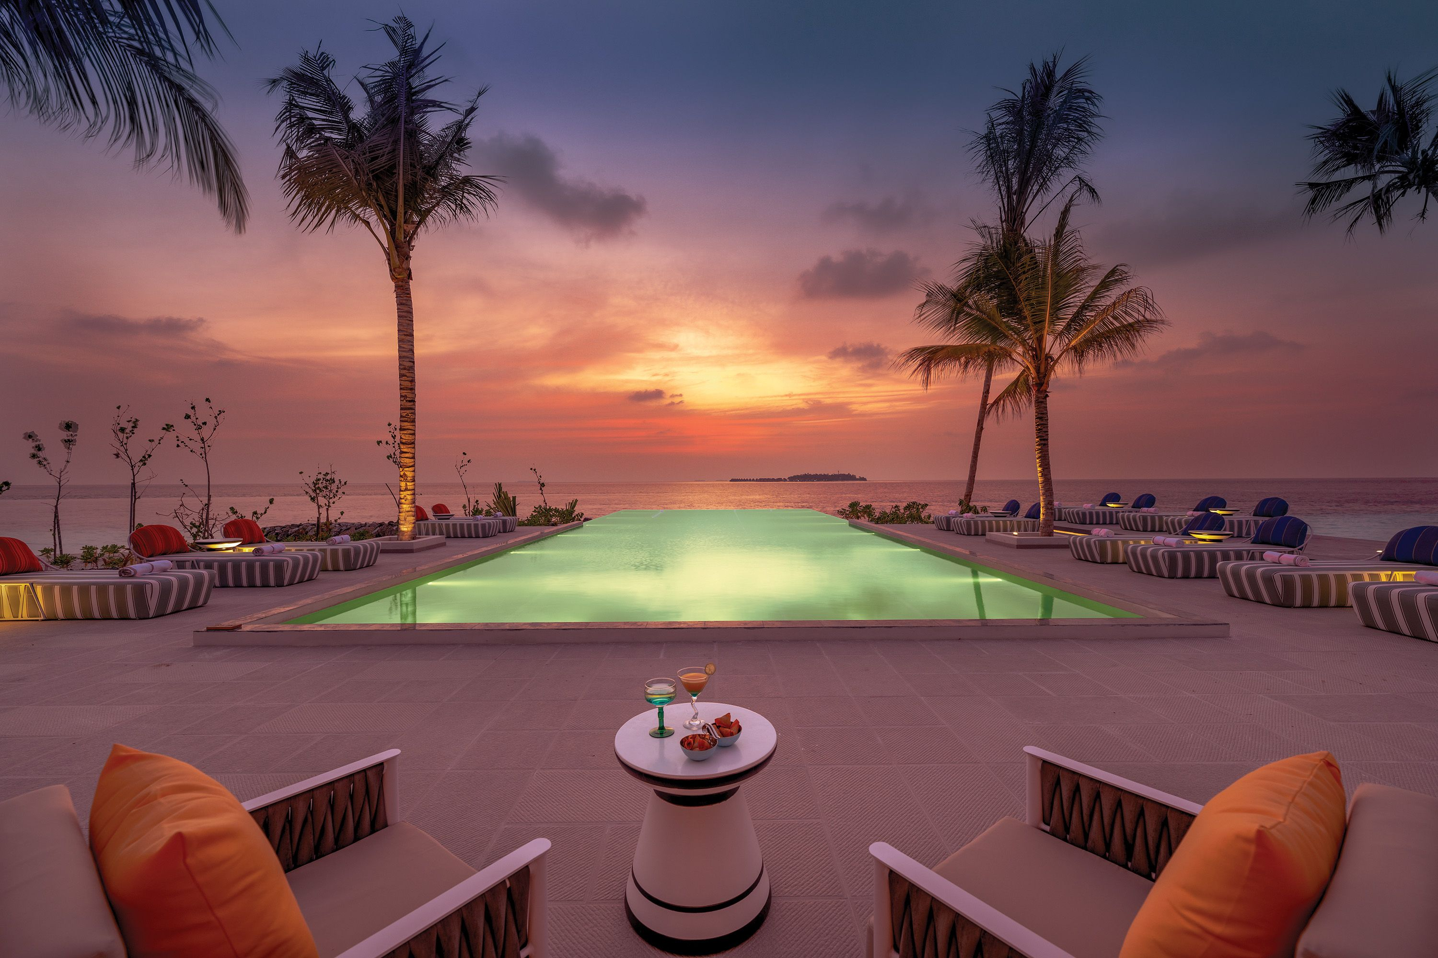
Swing Bar - At Sunset

Slide 38
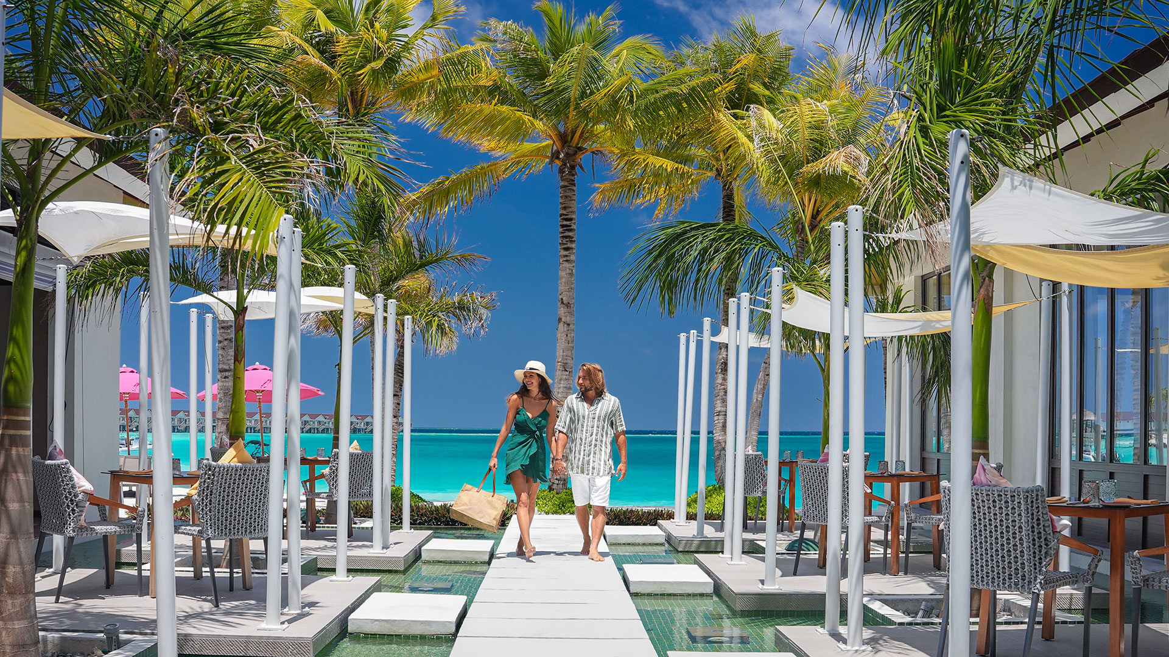
Ylang - Ylang

Slide 39
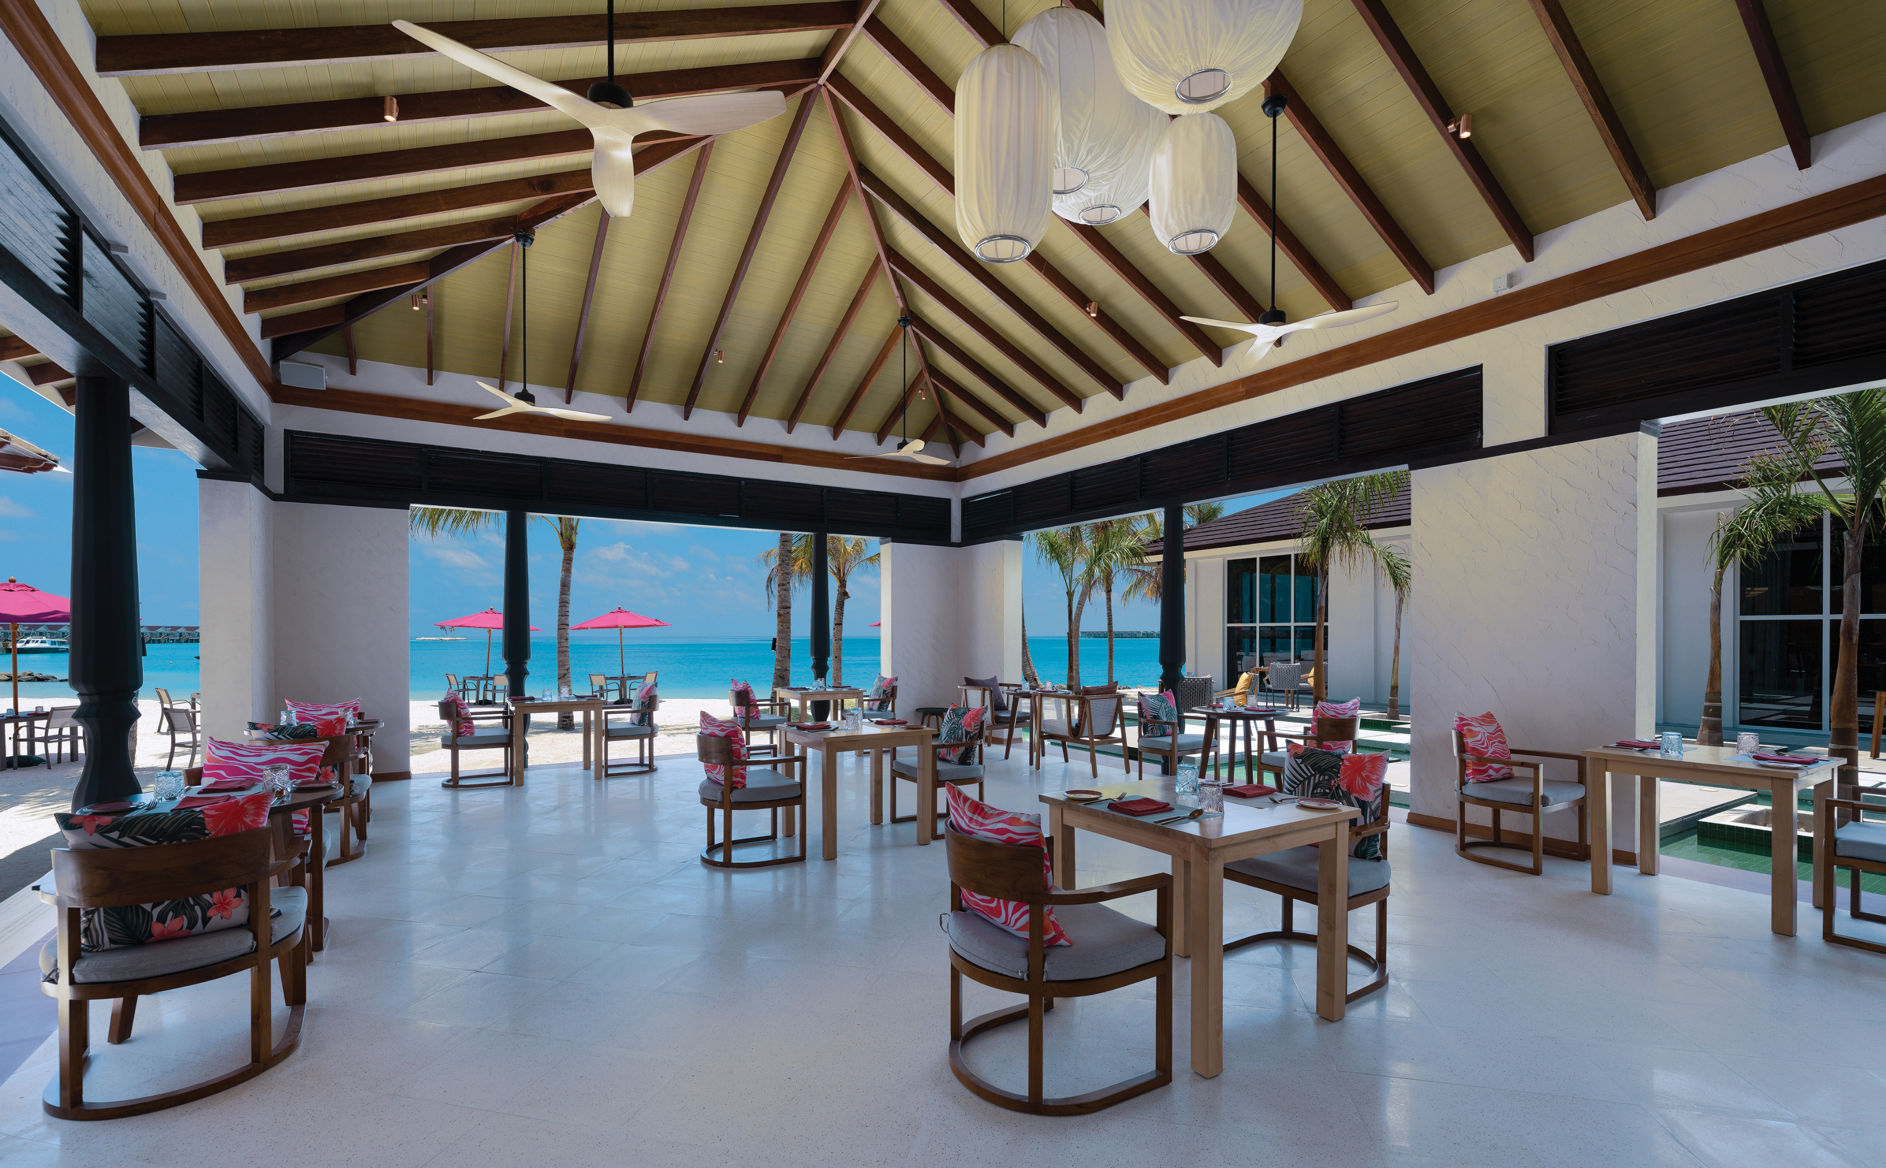
Ylang Ylang – At Lunch

Slide 40
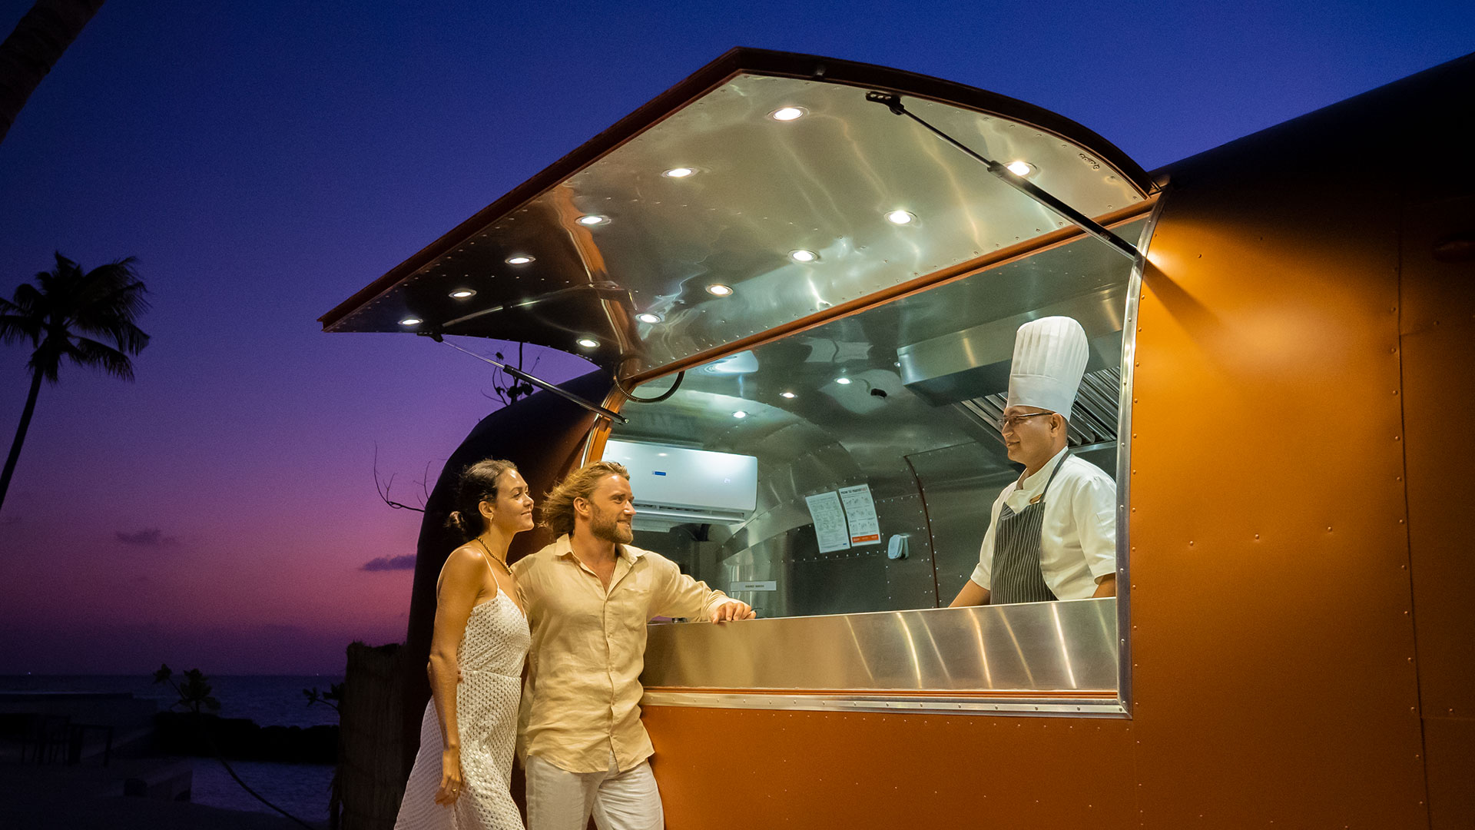
Gaadiya 17 – Food Truck

Slide 41
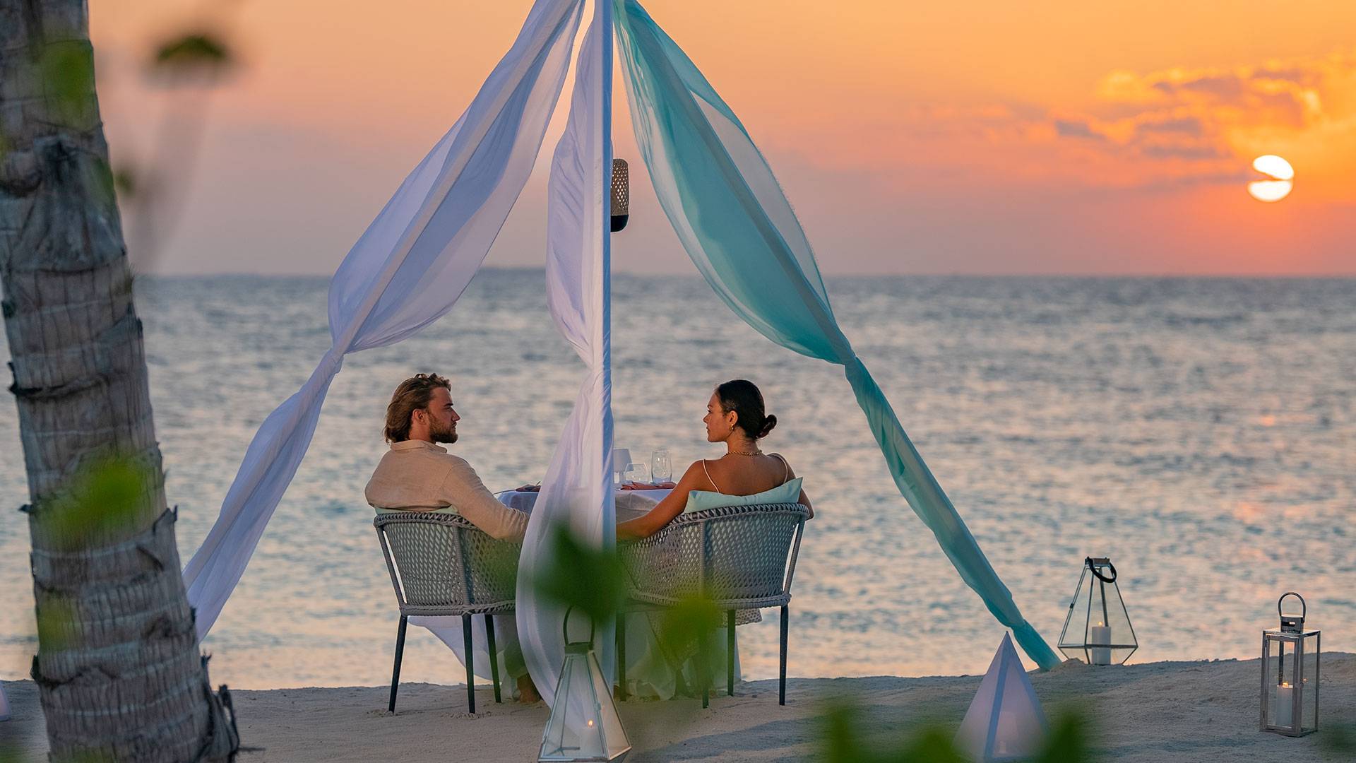
Dinner On The Beach

Slide 42
Watersports

Slide 43
The Island of Love
Only BLU - Under Ocean restaurant

